Slide 1
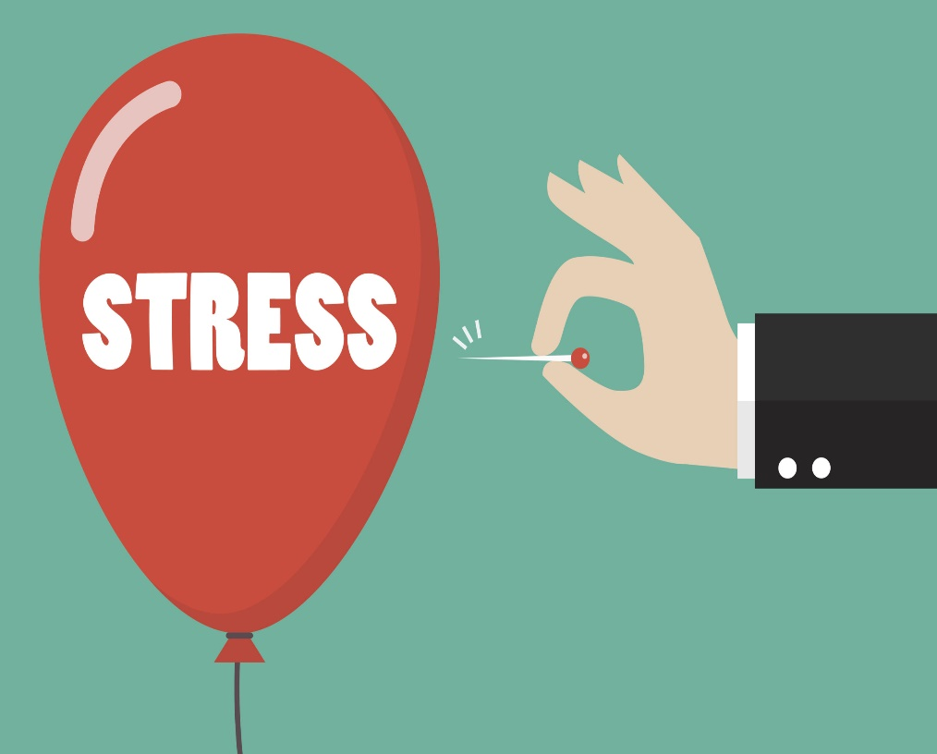
Coping with stress during the covid 19 pandemic
Samantha Roe
Crisis Intervention Officer MAN

Slide 2
What is stress?
While there is no official medical definition, stress can be associated with a feeling of being overwhelmed or feeling that you are not able to cope due to pressure.
Stress at it’s most basic level is, the body’s response to pressure. This pressure can come from a situation or life event. The experience of stress varies greatly from one person to another and can differ depending on our social and economic circumstances, and genetic makeup. Common things that can increase stress include experiencing something new or unexpected, something that threatens your feeling of self, or feeling you have little control over a situation.

Slide 3
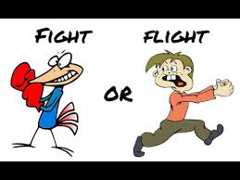
Fight or Flight
When stressed the body produces stress hormones which activate a ‘flight or fight’ response and trigger our immune system.
This response can be helpful and allow us to respond rapidly in dangerous situations.
Stress can be an appropriate, or even beneficial reaction.
Feeling ‘pressure’ can aid us to push through nerve-wracking or intense situations, like climbing a mountain, or public speaking.
After we are able to rapidly return to a resting state without any adverse effects if the stressor is short-term.

Slide 4
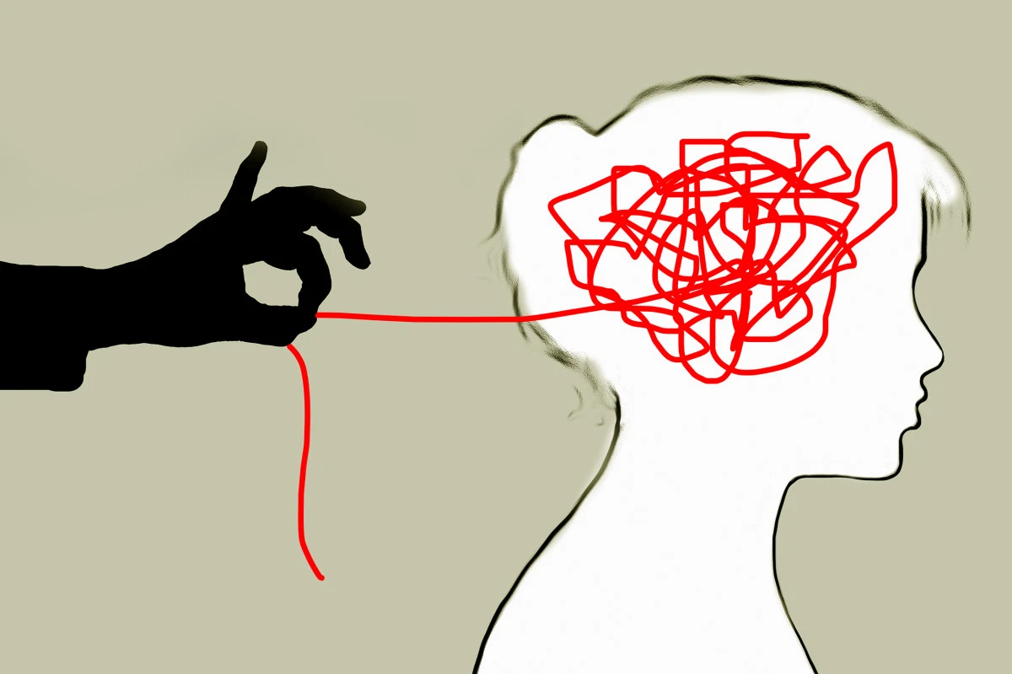
Symptoms of stress
There are many different symptoms that can be associated with stress.
You may experience physical or mental symptoms or a change in your behavior.
It can be easy to over look stress as the cause of a change in how you are feeling or acting.
Sometimes we do not recognise that we are stressed.

Slide 5
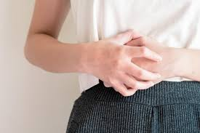
Physical symptoms of Stress
Headaches
Dizziness
Tension in the muscles or pain
Stomach issues
Chest pain (never ignore chest pain) or a faster heartbeat
Sexual problems

Slide 6
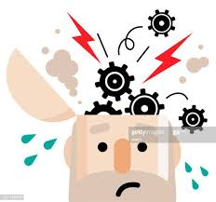
Mental Symptoms
Poor Concentration
Difficulty with decision making
Feeling overwhelmed
Over thinking or worrying more than normal
Forgetfulness

Slide 7
Behaviour changes
Easily irritable and short tempered
Feeling exhausted, sleeping to much or struggling to get to sleep
Sudden loss or increase of appetite
Social avoidance
Increased consumption of Alcohol or other self medicating

Slide 8
What’s causing my stress?
Causes of stress
Stress is usually a reaction to mental or emotional pressure. While at times there can be no obvious cause, stress is often related to feeling a loss of control.
When you're feeling anxious or scared the fight or flight reaction is triggered and your body releases stress hormones such as adrenaline and cortisol.
Some people feel that stress is beneficial for them and helps them to be more productive.
However if you are experiencing physical symptoms such as a faster heartbeat or sweating on an ongoing basis, then this is not a healthy level of stress .
If you're stressed all the time it can become a problem.

Slide 9
Managing The Cause
Managing stress is easier if you know what is causing it.
Here are some of the common factors that can trigger stress.
Feeling under pressure at work
Family dynamics, relationship issues, divorce, caring for someone.
Financial worries ( if you recently experienced financial distress as a result of the pandemic please contact our support worker on 02871377777 to help you explore your options.)
Illness, injury or general health worries
Bereavement
Buying/selling/moving house, having a baby or planning a wedding can all trigger stress
You might find it hard to understand why you are feeling this way but talking to someone can help.

Slide 10
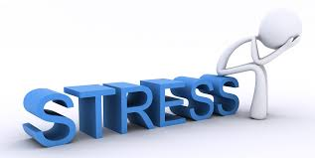
Mental wellbeing while staying at home
Taking care of your mind as well as your body is really important while staying at home because of coronavirus (COVID-19).
It’s understandable that you may feel frustrated lonely or anxious.
You may also be low, worried or tired, or concerned about your finances, health or loved ones.
Its can be helpful to know that it is perfectly normal to feel this way. This is not a normal situation and everyone’s reaction and feelings are valid and may differ.
It’s also helpful to remember that this is a temporary situation and for the majority of us these feelings will pass,it can be hard staying at home but please remember in doing so you are protecting yourself and others.
Remember, this situation is temporary and, for most of us, these feelings will pass.

Slide 11
What can I do? 1. Find out what your employment and benefit rights are.
If you are worrying about work and finances while you have to stay home – this kind of pressure can have a detrimental effect on your mental health.
If you have not already, please talk with your employer about working from home, and learn about your sick pay and benefits rights.
https://www.nidirect.gov.uk/articles/coronavirus-covid-19-and-benefits
Or if you need help to understand your rights please contact 02871377777 and our support worker will contact you back.

Slide 12
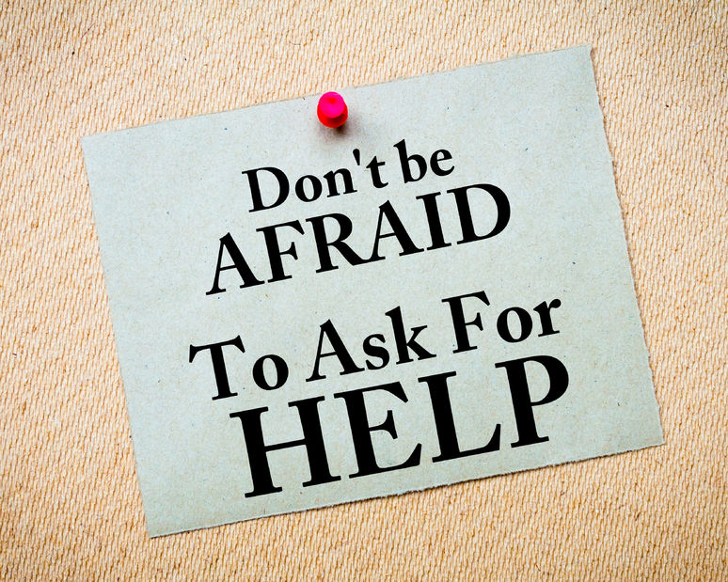
2. Plan practical things
Work out how you can get any household supplies you need. You could try asking neighbors or family friends, or find a delivery service.
Continue accessing treatment and support for any existing physical or mental health problems where possible. Let services know you are staying at home, and discuss how to continue receiving support.
If you repeat prescriptions you might be able to order repeat prescriptions by phone, or online via a website or app.
You can call your GP surgery and find out if they facilitate this. You can also ask your pharmacy about getting your medicine delivered, or ask someone else to collect it for you.
If you support or care for others, either in your home or by visiting them regularly, think about who can help out while you are staying at home.

Slide 13
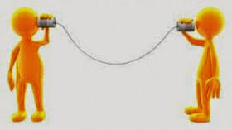
3. Stay in contact with others
Its important to maintain relationships with people you care about, healthy interaction is good for your mental wellbeing.
There are a variety of way that you can stay in touch with your family and friends during the pandemic such as, by phone, messaging, video calls or social media – whether it's people you usually see often, or connecting with old friends.
There are many people who are struggling with the current situation, keeping in touch may be as helpful for them as it is for you.

Slide 14
4. Talk about your worries
It’s natural to feel worried and anxious in the current situation. Those are perfectly valid feelings. Sharing these worries with someone you trust may be helpful to you and could be helpful for them too. If you are worried but don’t feel you can share these feelings with friends or family you can contact MAN on 02871377777 to speak with a counsellor.

Slide 15
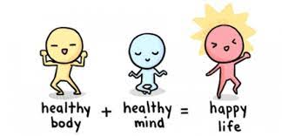
5. Look after your body
Our brain is an organ and our physical health can have a huge impact on how we feel. Try to be mindful of falling into unhealthy behavior patterns at the present time. This may be difficult but looking after your body really helps the mind too.
Try to eat a healthy diet , well-balanced meals, drink enough water and exercise regularly. Avoid smoking or drugs, and try not to drink too much alcohol and remember even though you may not be at work, every day is not the weekend. Be mindful of falling into bad habits with Alcohol. Try to maintain some structure.
If you are healthy and do not have a letter advising you to stay home you can leave your house, alone or with members of your household, for one form of exercise a day – like a walk, run or bike ride. But make sure you keep a safe 2-metre distance from others.

Slide 16
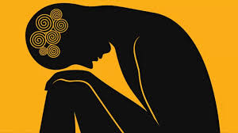
6. Learn to deal with difficult feelings
Having concerns and feeling worries about Corona Virus is completely normal right now. However, If you experience intense anxiety this can affect your day to day life
Try not to focus on things you have no control over. Focus on what is within your control such as, your reactions, where you get your information from and how much time you spend on social media sites.
It’s perfectly normal to understand that there are things that are outside of our control however, if you are experiencing constant thoughts about the situation that are causing you to feel anxious you might want to some ideas to help you manage this anxiety (https://www.mind.org.uk/information-support/types-of-mental-health-problems/anxiety-and-panic-attacks/self-care-for-anxiety/).

Slide 17
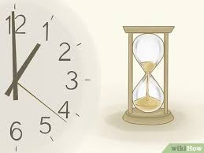
7. Take a break from the news
It’s healthy to be informed however, too much information can be overwhelming. Try and limit the amount of time spent watching, reading or listening to coverage of the pandemic.
This includes social media which can be inaccurate and alarmist.
Consider taking a break from your phone for a set time everyday and cancelling new alerts.
It may be a good idea to set a limit on the amount of time you spend online each day or the number of times you check your phone.
Doing this as a family may be a good idea.
Be mindful of the source of the information you are reading and try to get your information from reputable sources.

Slide 18
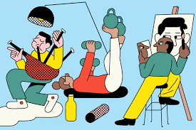
8. Carry on doing things you enjoy
It can be hard to do the things that we enjoy if we are feeling anxious, worried or stressed.
If you have a hobby that you are able to keep up at home then try and make use of this time to focus on that. If not picking up something new is a great option if you have time on your hands.
There are a wide variety of online tutorials and courses. People are becoming increasingly inventive with their ideas of things to do. Hosting a family quiz is a great way of staying in touch with everyone or you could even put on a concert or make funny videos.

Slide 19
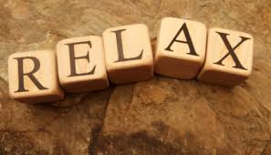
9. Find time to relax
Make sure that you take time out of your day to relax. This can sound hard but prioritising self care is very important especially if you are caring for others.
Taking time out can help with difficult emotions and worries, and improve our wellbeing. There are a number of simple relaxation techniques that can also help deal with feelings of anxiety.
https://www.mindful.org/a-five-minute-breathing-meditation/

Slide 20
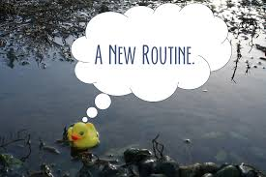
10. Think about your new daily routine
There’s no way of knowing how long our lives will be changing and it’s likely that it will be some time before they return to normal.
Think of ways to adapt and create positive new routines and set yourself goals.
It may be beneficial to plan ahead. Some people like to write out a plan for their day or for the full week.
This helps to provide structure and less uncertainty.
Working from home is new to many of us and it can be hard to get motivated.
Try to get up and dressed as usual and stick to your normal working hours, ensuring that you take your break and keep the same sleeping hours.
Working after sitting up really late is as hard and home as it is when you are going into work.

Slide 21
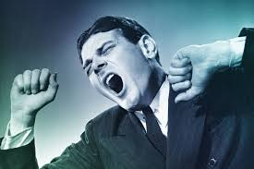
11.Sleep Matters
Not getting a healthy nights sleep can really affect how we function the next day and how we interact with others.
Try to ensure that you keep a good routine and mange at least the recommended 8hrs per night.
Routine is key so try and keep up your regular sleeping pattern

Slide 22
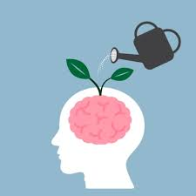
12. Keep your mind active
There are a number of things you can do to help keep your mind active.
We all need stimulation of some sort so try and take time to read, write, play games, do crosswords, complete sudoku puzzles, finish jigsaws, or try drawing and painting.
Find something that works for you!

Slide 23
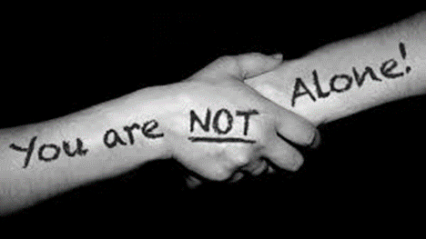
There is help…
Most of us experience stress at some time. During this current pandemic most people are out of routine or feeling more restricted that they would in every day life.
If you feel that stress is consuming your life and you feel unable to cope then there is support available.
You can contact Men’s Action Network directly on 02871377777

