Slide 1
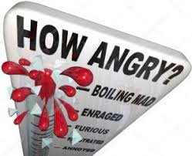
Exploring the Emotion of Anger
Samantha Roe
Crisis Intervention Officer MAN

Slide 2
The psychotherapist and author Gael Lindenfield : Managing Anger ISBN 0-00-710034-5 outlines in her book
Anger is a natural response to a hurt, frustration, bereavement, loss or threat.
It is said it stems from an unmet basic love need which connects to feelings of rejection, which are painful, and out of fear we become defensive and ANGRY.
We expect this love need to be meet primarily from our parents, but also from family, friends ,and in particular our partners , indeed from everyone we expect to be treated in a way that is :
Respectful - Caring - Nurturing - Kind - Honest – Patient – Committed - Forgiving – Compassionate
Protective – Safe “a loving , needs met way”
Anytime we feel we are treated in a “less than lovingly, not needs met, way” i.e. a way which is
Dismissive – Disowning – Belittling – Demeaning- Disloyal – Indifferent - Uncaring – or abusive in any form - we are likely to feel rejected and get angry
Your Voice, or Need, feels rejected, silenced or neutralised
A reflection :Have you been treated this way ,Do you treat others this way

Slide 3
The Feeling Wheel
As an exercise in identifying your unique feelings and emotions you are asked to explore each of the feeling oppisite and determine how you experience and exhibit them in your life.
Record thoughts feelings and behaviour/actions uniquely experinced by you for each word
As you explore each feeling you may notice that the intensity deepens as you move inwards within the section towards it’s core feeling.
Sections display opposite, alternative and healthier /safer ways of being and highlight areas that can be developed to re-balance experiences of feeling SAD, ANGRY or SCARED.
For the purpose of this presention the focus is on anger

Slide 4
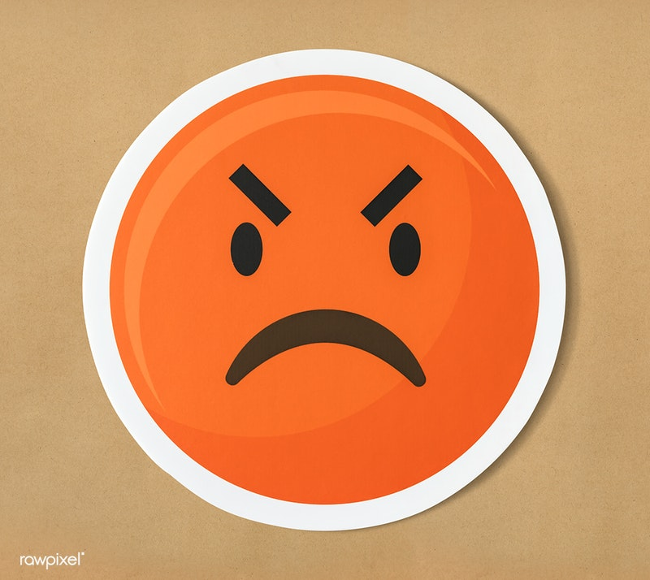
Exploring Anger
Introduction
Emotion is a word we use to explain how we feel in particular situation.
Anger is an emotion that many of us deal with on a daily basis.
In this part of the tool kit we will look at anger, where is comes from, it’s impact on us, our relationships and those around us.
We willl discuss physical effects that anger has on the body and its impact on our phyical health.
We will also explore some tips to help control and manage our anger.

Slide 5
Origins of anger
So you may be wondering where does anger come from?
Well research has shown that anger has evolved for good reason.
Throughout individual and collective history of the human race survival of human beings has been dependent on the energy and motivation generated by feelings of anger, triggering our desire to fight for change.
In this context ‘fight’ and ‘attack’ do not mean acts of physical aggression, but any response to a stimulus that is designed to right a perceived wrong.
Todays spurs for anger are much the same as the ones our ancestors had:
we or our loved ones may be under physical threat,
we may have suffered a blow to our self-esteem or place within a social group,
we may be losing a battle for resources,
someone may have violated a principle that we as individuals or in a group hold to be valuable,
or we may be thwarted or interrupted when we are pursuing a goal.
So anger is a natural part of our evolution.
Di Giuseppe and Tafrate, 2007, Understanding Anger Disorders, Oxford, 2007
Tavris C, Anger: The Misunderstood Emotion, Simon & Schuster, 1989

Slide 6
Understanding anger
While many may assume anger is a solitary emotion that is not the case. Anger is often accompanied by feelings of fear and shame. That is often the reason why many people wait until they are in a state of crisis before seeking help to manage their anger.
The base emotion may be anger however it is generally blurred or confused with other states of aggression or depression.
Anger is more common than many people realise.
A survey by the Mental Health Foundation found that 32% of people in the UK had a close friend or family member who has struggled to control their anger.
https://www.mentalhealth.org.uk/sites/default/files/boilingpoint.pdf

Slide 7
Why Am I Angry?
Having looked at the origins of anger we will explore what triggers feeling of anger in us.
One extensive study carried by S Mabel in 1994 identified 10 distinct stimuli or triggers for anger. Mabel S, Journal of Social and Clinical Psychology, 13 (2) Di Giuseppe and Tafrate, 2007, Understanding Anger Disorders
These where :
Interruption of goal-directed behaviour when time is important
Experiencing personal degradation or unfair treatment and being powerless to stop it
Being treated unfairly, unkindly or in a prejudicial way, whether or not one is present
Being the object of dishonesty or broken promises, being disappointed by others or oneself
Having one’s authority, feelings or property disregarded by others
Being ignored or treated badly by a significant other
Experiencing harm because of one’s negligence towards oneself
Being shown by others’ behaviour that they do not care
Being the object of verbal or physical assault
Being a ‘helpless victim’

Slide 8
A Common Denominator
If we think about how often we become angry, whether through, frustration, bereavement or being treated unfairly, it is clear that the majority of the time we are experiencing some kind of stress.
Anger is commonly a reaction to feeling under threat, hurt, or neglected which leads to stress. This stress can be a contributing factor in the development of anger.
Mike Fisher who is regarded as one of the UK’s leading experts on anger and Head of the British Association of Anger Management states that:
“Stress feeds anxiety which feeds shame which manifests in outbursts of anger.” (Mike Fisher 2018)
https://www.independent.co.uk/life-style/anger-management-expert-guide-identify-source-how-to-deal-with-rage-issues-stress-shame-depression-a7534076.html

Slide 9
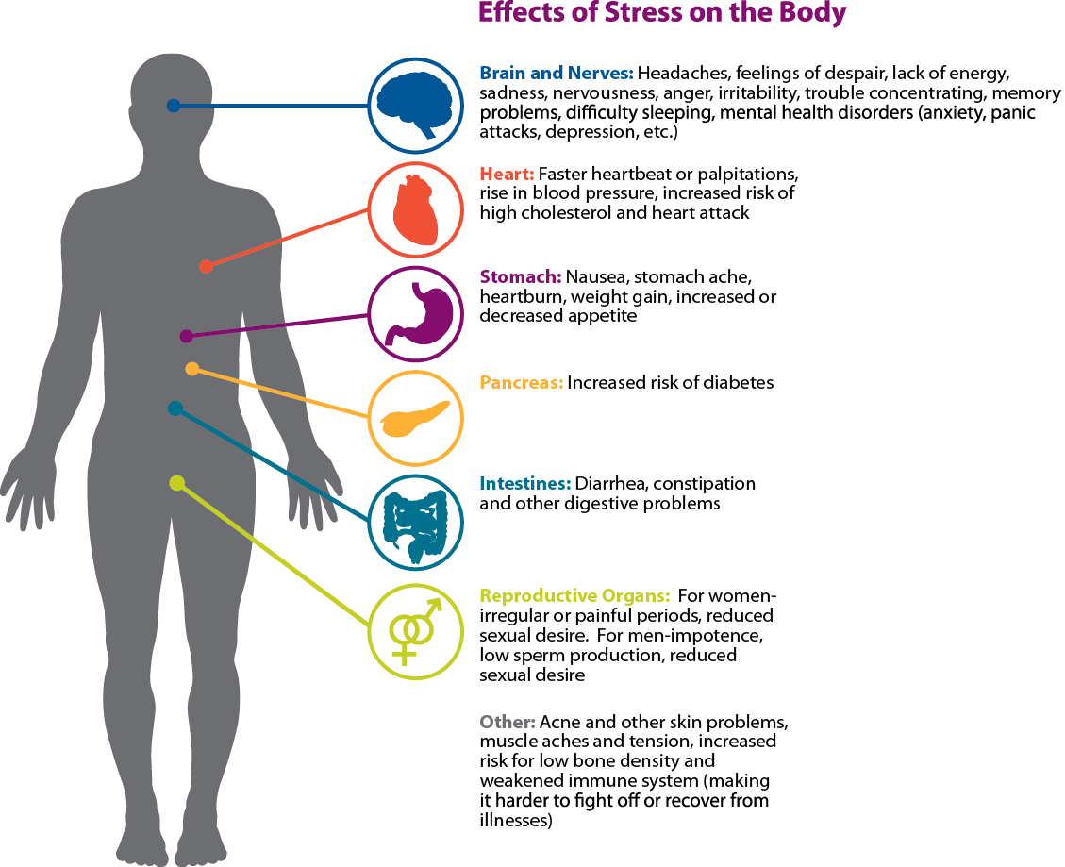
Sometime we are not aware that we are under stress. It is important to be able to recognise stress. There are a number of physical symptoms of stress that are helpful to be aware of.

Slide 10
Below some tips from The Mental Health Foundation to help manage stress
Realise when it is causing you a problem
Try to make the connection between feeling tired or ill and the pressures you are faced with.
Look out for physical warnings such as tense muscles, over-tiredness, headaches or migraines.
2. Identify the causes
Sort the possible reasons for your stress into three categories
1) those with a practical solution
2) those that will get better given time
3) those you can’t do anything about
Try to release the worry of those in the second and third groups and let them go
3. Review your lifestyle
Could you be taking on too much?
Are there things you are doing which could be handed over to someone else?
Can you do things in a more leisurely way?
Acting on the answers to these questions may require prioritising things you are trying to achieve and re-organising your life to release the pressure that can come from trying to do everything at once
https://www.mentalhealth.org.uk/publications/how-manage-and-reduce-stress

Slide 11
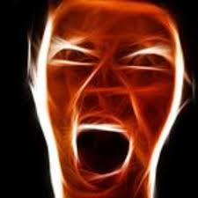
Now we have established the relationship between anger and stress and the symptoms of stress, we will now look at the physical responses that our bodies have when we are angry.
Some of us may not be aware in how our anger manifests physically and may not realise how this physical manifestation of anger can make others feel.
It is important to be aware of the physical changes that happen in our bodies when we are angry and be aware of the effect that anger has on others.
Recognising our emotions is key to being able to manage them.

Slide 12
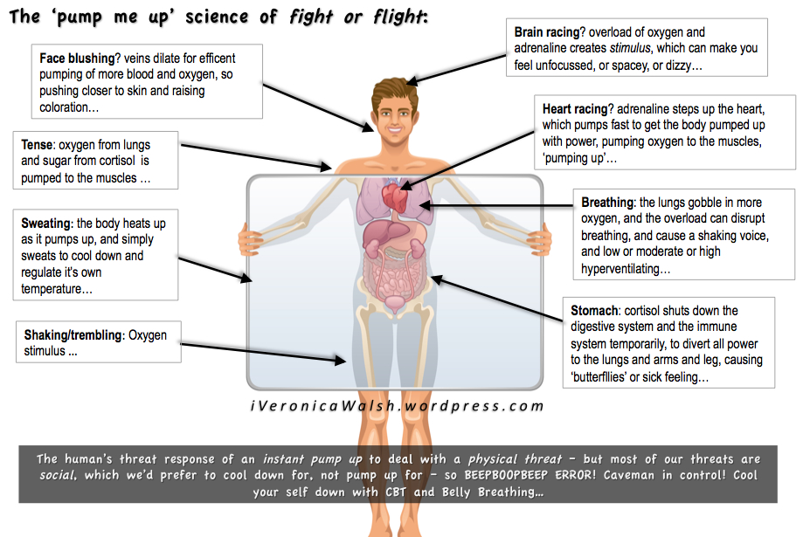
Anger and the body
When we are angry our body releases a hormone called adrenalin, this is part of the body reacting to stress and activating the ‘fight or flight’ response.
This response goes back to our primal instincts and when we feel threat our body will prepare itself to do one of two things, stay and fight or prepare to flee.
The activation of this response has a physical effect on our bodies. These are some of the physical responses that you may have when you feel angry.

Slide 13
How others may see anger in you
You are panting
Your pulse is racing (maybe visible on your temple)
Your eyes are more widely open than usual and your pupil are dilated
Your facial colour gets refer, but them may turn pale
You are more sensitive to sound
You have more physical strength that usual
Your voice is louder
Your speech is quicker
Your movements are quicker
Your muscles are tense

Slide 14
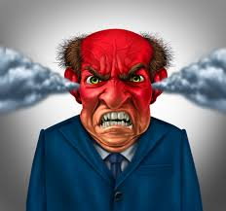
How does anger feel
As a result of all the physical changes and release of hormones in the body, we are likely to feel more alert, on guard or hyper vigilant.
When someone is angry they are likely to feel an increase in temperature, feel their heart beating or experience palpitations and have a surge of energy, the urge to move physically or raise our voices.
Recognising these physical symptoms is essential in managing anger.

Slide 15
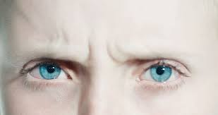
You may NOT notice all of the PHYSICal signs IN YOURSELF when you get angry though other people are likely to observe these changes.
However you may be more able to see these things yourself in others and use them to aid your own self awareness
Remember most of the time we don’t think about how we are acting and …
In someone else's eyes, I am only how I am behaving to them,
And in my eyes, they are only how they are behaving to me.
These signs highlight the heightened physical arousal state which anger induces which puts considerable strain on your body.
Remember anger is only supposed to be a temporary state.s

Slide 16
The stigma of anger.
Many people feel a sense of shame when talking about their anger.
this shame is in fact part of the reason so many people struggle to get help with anger.
What is important to recognise is that anger is a natural emotion and we all have it.
a survey by the Mental Health foundation found that More than one in four of us (28%) say that we worry about how angry we sometimes feel.
https://www.mentalhealth.org.uk/sites/default/files/boilingpoint.pdf
What’s important is to ensure that we do not let it take over our lives or the lives of those impacted by our anger.
However while it is healthy to feel and recognise our emotions, anger should not be a permanent state.

Slide 17
Tips to help manage anger.
Mike Fisher (2018)Head of the British Association of Anger management gives 5 tips to help manage anger at it’s early stages.
“Stop and take a look at the big picture. When you are very angry try to see beyond your own anger and look at it from a 360 degree perspective. See how other people are reacting to you.
Secondly, it’s OK to have a different opinion. We are in a world where people are seen as right or wrong and anyone who doesn’t agree with your should shut up. When you invalidate someone’s experience that creates conflict. But we need to accept that other people have different realities.
Listen.
Listening when angry is impossible
Use support. In the UK culture we don’t reach out for support because of our stiff upper lip and we don’t say we’re suffering. We say things like OK, not bad could be better but don’t get to the nitty gritty of what we’re experiencing. Listening is fundamental with communicating especially with feelings we associate with anger. Another rule is communicating, sharing and using support. It’s fundamental that we find ways to listen to people and be authentic in what we’re thinking. Using an anger journal is also great because it helps you to not let the anger take space in your head.
Finally the biggest one is don’t take anything personally.
It’s easy to say that but ‘very hard to do”

Slide 18
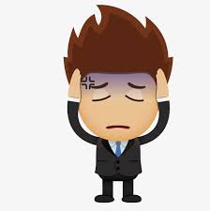
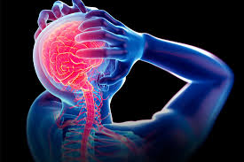
Impact of Anger on the body
If anger is not dealt with or released it builds up over time and can have a very significant impact on your well being. Let’s now look at the impact on well being and vitality of people who regularly experience anger.
Anger can cause or make worse digestive disorders such as ulcers and gastritis through the increase of acid secretion as well as;
Create hypertension
Raise your cholesterol levels
Damage and block your arteries
Aggravate heart disease
Exacerbate bowel conditions such as colitis
Increase your susceptibility to infection
Intensify pain
Create headaches and exacerbate sinus conditions
Contribute to inflammatory disorders of the muscles

Slide 19
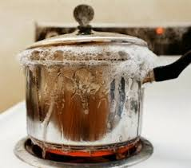
Summary
Anger is a natural response to hurt, frustration, stress or threat that has evolved over time
It physically alters our body chemistry
We can learn to notice signs of anger in ourselves and others
Anger should be a temporary state
Unresolved/unreleased anger causes strain on our body
If anger is getting the better of you and you feel that it is taking over your life it is important to seek help and support to manage this.
There are numerous routes you can take, from counselling to Anger Awareness courses.
Please email admin@man-ni.org to find out more about our services to assist you if you wish to address your anger issues

